Slide 1
Techniques for Improving Training Time of Deep Neural Networks with Applications to Speech Recognition
Tara N. Sainath
(in collaboration with Brian Kingsbury, Hagen Soltau, George Saon, Bhuvana Ramabhadran, I-shin Chung, Michael Picheny)
IBM T.J. Watson Research Center
December 19, 2013
Notes:
To replace the title / subtitle with your own:
Click on the title block -> select all the text by pressing Ctrl+A -> press Delete key -> type your own text

Slide 2
Outline
Deep Neural Networks for Speech Recognition
Improving Training Time
Reducing Parameters with Low-Rank Matrices
GPUs for SGD training
2nd order Hessian-free (HF) optimization
Sampling and pre-conditioning for HF training
Improvements to HF with Blue-Gene
Future Work

Slide 3
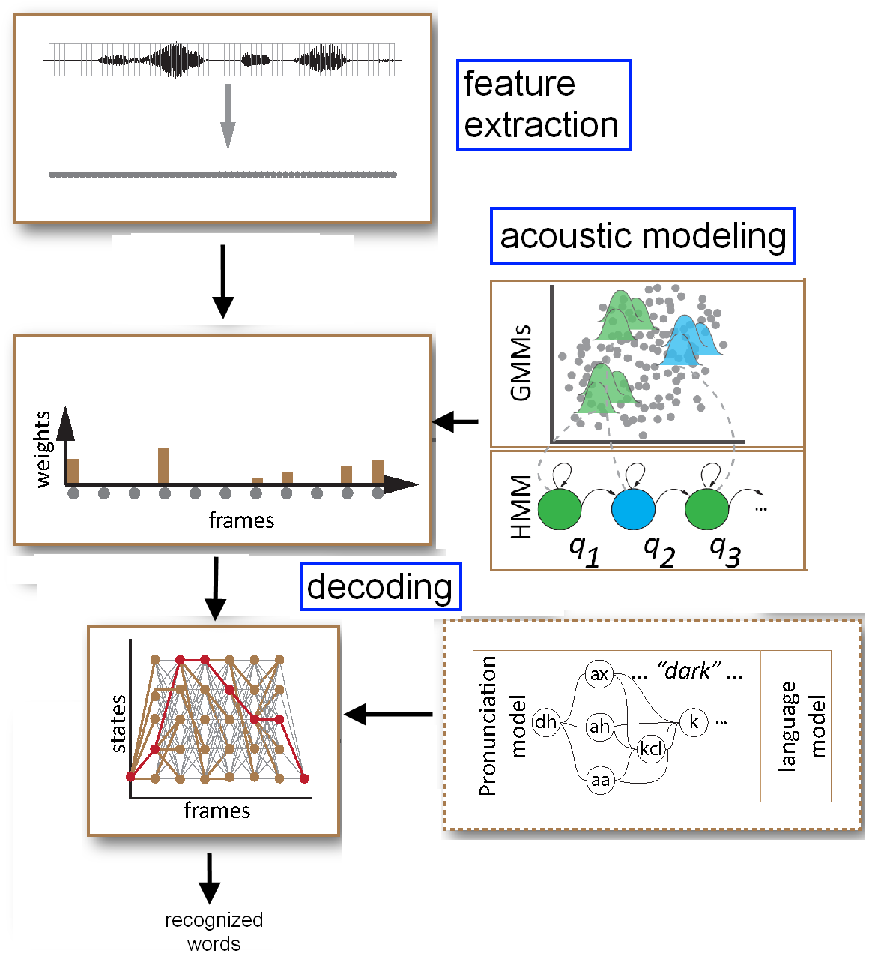
Speech Recognition Problem
Given a waveform, the speech recognition problem is to find the best set of words
This process is broken into 3 main modules:
Feature extraction to represent signal with features
Acoustic modeling to score features against a set of classes
Decoding to find the best set of recognized words

Slide 4
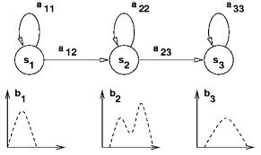
Acoustic Modeling for Speech Recognition
Speech recognition problem characterized as follows:
Acoustic modeling is the process of modeling a set of sub-word units which make up words
Each sub-word unit is modeled by a 3-state Hidden Markov Model
The most dominant acoustic modeling technique thusfar is to model the output distribution in each state by a Gaussian Mixture Models (GMM)
Neural Networks (alternatively called Multi Layer Perceptrons – MLPs) can also be used for acoustic modeling

Slide 5
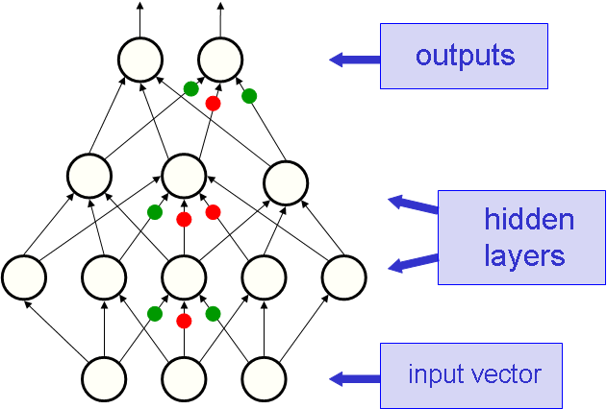
Multi-layer Perceptrons
Create an MLP with outputs being # of sub-word units
MLP outputs are P(class|input)
MLP output probabilities are used for the acoustic model scores
Multi-Layer Perceptrons [Morgan, 1993]
typically looked at shallow networks with few output targets, as it is easy to get stuck in local optima
did not outperform GMM/HMM systems
Deep Neural Networks [Hinton, 2006]
Look at pre-training MLP weights in an unsupervised fashion
address problems with MLPs and encourage deeper networks with more output targets

Slide 6
Why Deepness?
Deep architectures with multiple hidden layers can learn more higher-level, abstract representations of the input.

Slide 7
Training DNNs
First, (optionally) pre-train weights in each layer
Second, fine-tuning via backpropagation retunes weights by minimizing loss between target and hypothesized classes
Two-stages to fine-tuning for speech recognition problems:
Frame-level cross-entropy objective (CE) function
Sequence-level Minimum Bayes Risk (sMBR) objective function [Kingsbury, 2009]
Challenges with DNN training include a non-convex objective function and a large number of network parameters
Training can be done via stochastic gradient descent (SGD), serially on one machine, or via data-parallel 2nd order methods

Slide 8
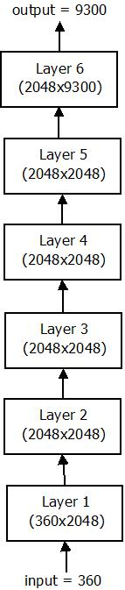
DNN Architecture for Speech Tasks
We use the following architecture
6-7 hidden layers
1,024 – 2,048 hidden units
4,000 – 9,000 output targets
This amounts to anywhere between 8-40 million parameters!
Each weight update involves a large number of dense matrix multiplications:
propagating the input forward
computing the gradient
propagating the gradient backward

Slide 9
Deep Neural Networks for Speech Recognition
DNN acoustic models have shown tremendous success over the past few years
DNNs provide between a 18-27% relative improvement in word error rate over our state-of-the-art speaker-adapted, discriminatively-trained GMM/HMM systems across a variety of tasks and languages
 | 50 Hour Broadcast News | 300 Hour Conversational Telephony | 430 Hour English Broadcast News
GMM/HMM | 18.8 | 14.3 | 16.0
CNN | 15.4 | 10.4 | 12.7
% Relative Improvement | 18.1 | 27.3 | 20.1

Slide 10
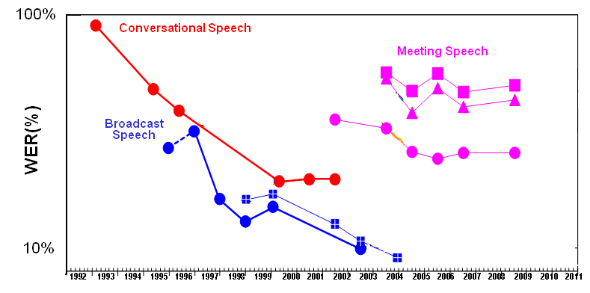
Historical Performance in Speech Recognition
Few techniques we explore consistently show gains of this magnitude
Performance with
Deep Neural Networks

Slide 11
Challenges in Training Time
While DBN performance in speech recognition is promising, our biggest overall challenge remains training time
300 Hr SWB Timing Results (92 million frames)
Architecture - 360 dim input, 7 layers, 2,048 hidden units per layer, 9,300 output targets (43 million parameters)
On a 12 core CPU, SGD cross-entropy training takes 26.5 days!
GMM systems are much quicker to train
2 days to train same 300 hr SWB system
Training is slow due to:
large number of parameters
large number of dense matrix multiplications
simplicity of SGD with serial training on one machine
In reality, 300 hours is small for us. We want to train systems on 10,000+ hours plus of data

Slide 12
Outline
Deep Neural Networks for Speech Recognition
Improving Training Time
Reducing Parameters with Low-Rank Matrices
GPU training
2nd order Hessian-free (HF) optimization
Sampling and pre-conditioning HF optimization
Improvements to HF with Blue-Gene
Future Work

Slide 13
Motivation
DNNs for acoustic modeling using posteriors as output probabilities in HMM
Typically use output targets of similar size to number of context-dependent states (sub-word units) in a GMM/HMM to model variability in data
DNN hybrid systems show improved performance by using a large number of output targets
Increased output targets does not come for free…
Output Targets | WER
384 | 21.3
512 | 20.8
1,024 | 19.4
2,220 | 18.5

Slide 14
Motivation
Having a large number of output targets has drawbacks
Causes number of parameters to increase significantly
Which in turn increases training time significantly
Case Study: 300 hours of Switchboard
DNN is 43 M parameters (7 layers, 2048 hidden units, 9,300 output targets)
Almost 50% of DNN parameters are due to the 9,300 output targets
Are there special properties of the last layer that can allow us to reduce parameters?

Slide 15
Motivation
We can probably assume the following about the last layer
Only a few classes are active
These active classes are probably correlated
If this is true, can we represent the output layer matrix as one with low rank?
Representing the last layer as a low-rank matrix can reduce number of parameters of the network

Slide 16
Rank Factorization
Given matrix C of rank r and size m×n, we can express C as
C = A*B
A is m×r
B is r×n
New matrix A*B has r×(m+n) parameters
Number of parameters reduced if

Slide 17
Low-Rank Algorithm
[T. Sainath, B. Kingsbury, V. Sindhwani, E. Arisoy, B. Ramabhadran – ICASSP 2013]
Output targets
Low rank matrix factorization
Layer 6
Softmax
Output targets
Layer 6
1024x2220
Layer 6
Softmax
.
.
.
Layer 6b
r x 2,220
Layer 2
1024x1024
Layer 6a
1024 x r
Layer 1
Sigmoid
Layer 1
360x1024
Using a small r greatly reduces number
of parameters
What should r be?
Input (360x256)

Slide 18
Low-Rank for Cross-Entropy Training
Initial experiments on a 50-hr English Broadcast News task
Baseline DNN
Trained with fMLLR features
6 layers, 2,220 output targets
WER: 17.7, 6.8M params
We can reduce parameters by 28% with no loss in accuracy!
28% reduction in parameters amounts to a 1.4x speedup
Rank | WER | Params (% Reduction)
Baseline | 17.7 | 6.8M
768 | 17.4 | 7.1M (more)
512 | 17.3 | 6.2M (10%)
256 | 17.6 | 5.4M (20%)
128 | 17.7 | 5.0M (28%)
64 | 18.0 | 4.8M (30%)
32 | 18.3 | 4.7M (31%)

Slide 19
Analysis of Low-Rank Layer
Plot the spectral norm error between final layer full-rank matrix and its best rank-r approximation
Decreasing parameters by 30% results in a small spectral norm error of 0.05
Number of active targets is approximately 128
Decreasing parameters by 30% with a low-rank approximation seems justified

Slide 20
Low-Rank for Larger Broadcast News Task
430 hr English Broadcast News Task
DNN details
trained with fMLLR features
6 layers, 1,024 hidden units/layer and 6,000 output targets
Low-rank results reported on dev04f after CE and HF training
With larger tasks and more output targets, benefits of low-rank are even greater
Can achieve between a 49% reduction in parameters
No loss in accuracy
Method | WER- CE | WER-Seq | # Params
Baseline DNN | 16.7 | 15.1 | 10.7M
Low-Rank DNN (r=128) | 16.6 | 15.1 | 5.5M (49% reduction)

Slide 21
Low-Rank for Larger Switchboard Task
300 hr Switchboard Task
DNN details
trained with fMLLR features
6 layers, 2,048 hidden units/layer and 9,300 output targets
Low-rank results reported on Hub5-2000 after CE +Seq training
Low-rank factorization shows improvements on SWB as well
Can achieve between a 32% reduction in parameters
No loss in accuracy
Method | WER-CE | WER-Seq | # Params
Baseline DNN | 14.2 | 12.2 | 41M
Low-Rank DNN (r=512) | 14.4 | 12.2 | 28M (32% reduction)

Slide 22
Outline
Deep Neural Networks for Speech Recognition
Improving Training Time
Reducing Parameters with Low-Rank Matrices
GPUs for SGD training
2nd order Hessian-free (HF) optimization
Sampling and pre-conditioning for HF training
Improvements to HF with Blue-Gene
Future Work

Slide 23
Stochastic Gradient Descent (SGD)
Mini-batch SGD remains the most popular approach for fine-tuning
Gradient is difficult be parallelized because:
batch size B is small (100-1,000 training examples)
number of parameters w is large (10-50M)
cost to compute gradient and communicate parameters is high
If we make the batch size too large, we miss many local optima in objective function and training becomes unstable
The simplest way to speed up SGD training is via GPUs
Method | WER
Batch Size = 100 | 19.6
Batch Size = 500 | 19.6
Batch Size = 2000 | 20.0

Slide 24
GPU training
One reason DNN training is slow is due to the large number of dense matrix multiplications
GPUs help for SGD by parallelizing this matrix multiplication over thousands of cores
We can achieve over a 5x speedup with a K20x GPU compared to a 8-core CPU for cross-entropy (CE) training
But SGD does not work well for sequence training…
Method | WER (50-hr BN) | Training Time (hrs)
SGD (CPU) | 17.8 | 18.7
SGD (GPU) | 17.8 | 3.5

Slide 25
Outline
Deep Neural Networks for Speech Recognition
Improving Training Time
Reducing Parameters with Low-Rank Matrices
GPUs for SGD training
2nd order Hessian-free (HF) optimization
Sampling and pre-conditioning for HF training
Improvements to HF with Blue-Gene
Future Work

Slide 26
2nd Order Optimization
[J. Martens – ICML 2010]
Distributed optimization techniques, such as 2nd order methods, use large data batches for gradient and curvature information, which can be parallelized across machines
Minimize the following objective function
Find the best search direction d_{n}
Update parameters
Iterate

Slide 27
Using CG with DNNs
We use linear conjugate gradient to minimize the following objective function
using only matrix-vector products B(w_{n})d_{n} [Perlmutter, 1994]
Curvature matrix-vector products B(w_{n})d_{n} are computed in linear time and memory
Since the Hessian matrix is not guaranteed to be positive definite, we approximate this with a positive semi-definite Gauss-Newton matrix and then damp this

Slide 28
Distributed Implementation
[B. Kingsbury, T. N. Sainath, H. Soltau – Interspeech 2012]
Master-slave architecture use for HF training
Master runs the optimization
On each HF iteration, workers compute the following:
Compute loss L(w_{n}) given current model w_{n}
Compute the gradient ∇L(w_{n}) over all training data
Run multiple CG iterations, computing the Hessian matrix-vector product B(w_{n})d_{n} over small sample of the data (1-3%) for each iteration

Slide 29
HF vs. SGD, Cross-Entropy
There is no difference in performance between SGD and HF for cross-entropy (CE) training
2nd order methods like HF generally require more iterations than SGD, particularly when starting from a poor initial model (i.e. pre-trained weights) making them slow for CE training
Method | WER (50-hr BN) | Training Time (hrs)
SGD (CPU) | 17.8 | 18.7
SGD (GPU) | 17.8 | 3.5
HF (64 CPU machines) | 17.8 | 68.7

Slide 30
HF vs. SGD: Performance and Training Time
[ G. Saon and H. Soltau – ICASSP 2014]
For sequence-training, training is randomized at the utterance level rather than frame level due to sequence information
For CE with SGD, utterance randomization increases WER by > 1% compared to frame randomization, it likely does for sequence-training as well
HF does not care about utterance vs. frame as gradient is computed on all of the data
Takeaway messages:
HF is faster than SGD on CPUs since start from a better initial model (CE models)
While SGD is faster on GPUs, WER is worse
For sequence-training, HF is preferred over SGD
Method | WER (50-hr BN) | Training Time (hrs)
SGD (CPU) | 13.3 | 101
SGD (GPU) | 13.3 | 9.2
HF (64 CPU machines) | 12.9 | 18.7

Slide 31
Outline
Deep Neural Networks for Speech Recognition
Improving Training Time
Reducing Parameters with Low-Rank Matrices
GPUs for SGD training
2nd order Hessian-free (HF) optimization
Sampling and pre-conditioning for HF training
Improvements to HF with Blue-Gene
Future Work

Slide 32
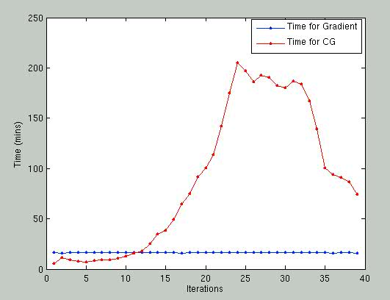
Training Time Dominated by Conjugate Gradient

Slide 33
Pre-conditioning
All 2nd order techniques involve solving the following problem for the search direction d
Popular approaches include CG and L-BFGS
L-BFGS
L-BFGS is a cheap and simple algorithm
crudely approximates the curvature matrix compared to CG, which does not always allow identification of directions with extremely low curvature
Pre-conditioning applies a change of coordinates to the CG problem which makes the CG problem easier to solve
Finding a proper pre-conditioner is a challenging task

Slide 34
L-BFGS for Preconditioning
Jacobi preconditioner has been popular for HF
reduces the number of iterations
expensive to compute as it requires distributed computation
We believe L-BFGS can be an effective pre-conditioner to CG
complimentary structural assumptions to CG
not computationally expensive as we get the stats from CG (search direction and residuals)
No distributed computation
We explore using the Hessian estimated by L- BFGS as the preconditioner for CG

Slide 35
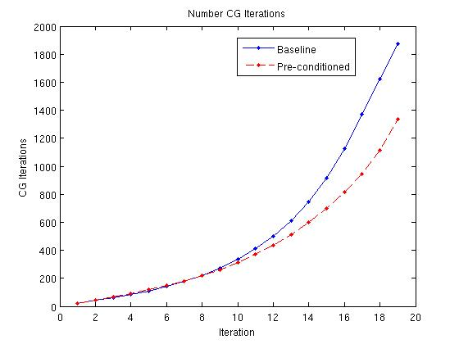
Speedups with Pre-conditioning
50 hr BN
300 hr SWB
Roughly 20% reduction in CG iterations on a 50 hr BN task
Roughly 30% reduction in CG iterations on 300 hr SWB task

Slide 36
Sampling Gradient and Conjugate Gradient
For each iteration,
gradient is computed on all data
curvature matrix-vector product computed on subset of the data
Optimization methods generally fall into two regimes
Stochastic approximation regime
Gradient computed over small set of training points
Steps are inexpensive but noisy
Batch (Sample Average Gradient) methods
Larger samples used to compute gradient (can be parallelized)
Steps are expensive but more reliable
We develop a sampling strategy where we geometrically grow the sampling size from stochastic to batch

Slide 37
Sampling Approach
Variance sampling [Bryd and Nocedal, 2012]
Want to ensure that the optimization algorithm making progress on objective function J_{s} is also making progress on true objective function J
Sample size based on variance estimates obtained during the computation of a batch gradient.
Geometric sampling [Friedlander, 2012]
Amount of data used for gradient and CG increased geometrically each time

Slide 38
Sampling Results
With variance sampling, we need many samples in the beginning compared to geometric, so it is slower
While geometric is simple, seems to work well in practice
We find that a good geometric rate is one that we see roughly 100% of the data after 50-60% of the total number of iterations

Slide 39
Results
[T. N. Sainath, L. Horesh, B. Kingsbury, A. Aravkin, B. Ramabhadran – ASRU 2013]
Using pre-conditioning + sampling
1.5x speedup on 50 hrs BN
2.5x speedup on 300 hrs SWB
50 hr BN
Method | Loss | WER | Total Time (hrs)
Baseline | 1.91 | 17.8 | 68.7
Speedup | 1.91 | 17.8 | 44.5
300 Hr SWB
Method | Loss | WER | Total Accessed Data Points
Baseline | 0.168 | 12.5 | 2.5e9
Speedup | 0.168 | 12.5 | 9.9e8

Slide 40
Outline
Deep Neural Networks for Speech Recognition
Improving Training Time
Reducing Parameters with Low-Rank Matrices
GPU training
2nd order Hessian-free (HF) optimization
Sampling and pre-conditioning for HF training
Improvements to HF with Blue-Gene
Future Work

Slide 41
Motivation
A major problem with parallel architectures is communication bottlenecks between workers
Having a specialized hardware/software architecture to minimize these bottlenecks is critical
The Blue Gene/Q architecture is perfect for 2nd order parallel HF training

Slide 42
Blue Gene/Q Architecture
Hardware:
Processor is a system-on-chip multi-core processor with 16 A2 PowerPC 64-bit cores.
Each A2 core runs at 1.6 GHz and is 4-way multi-threaded.
Software:
Open source and standards-based programming environment
Lightweight Compute Node Kernel ensures scaling with no OS jitter, enables reproducible runtime results
From system software to hardware architecture, dedicated resource to achieve high performance
No virtual memory
No context switch

Slide 43
Overall Speedups with BG/Q
[I. Chung, T.N. Sainath et al,
submitted to HPC 2014]
Experiments run on one BG/Q rack (1,024 nodes, 16 cores/node, 4 threads/core)
Compare BG/Q to SGD GPU and HF CPU implementation on 64 8-core Intel machines
On 50-hr BN, we find the following speedups with no loss in accuracy :
For CE: 12x speedup over Intel-CPUs and 2.7x speedup over GPU
For Sequence training: 8x speedup over Intel-CPUs and 6x speedup over GPU
On 430-hr English BN task (175m training examples), with 2 racks (8192 ranks), BG/Q was over 50x faster than Intel-CPUs 12x faster than a GPU
A specialized architecture such as BG/Q makes HF the fastest approach for CE and Sequence training

Slide 44
Outline
Deep Neural Networks for Speech Recognition
Improving Training Time
Reducing Parameters with Low-Rank Matrices
GPU training
2nd order Hessian-free (HF) optimization
Sampling and pre-conditioning for HF training
Improvements to HF with Blue-Gene
Future Work

Slide 45
Future Directions
DNNs are extremely promising in speech and vision tasks, though training time remains challenging
Better hardware approaches
FPGAs
training with multiple GPUs
Better algorithms:
asynchronous SGD [J. Dean, NIPS 2012]
improving parallel matrix multiplication
parallelizing SGD using larger batch sizes [T.N. Sainath – NIPS Workshop 2012]

Slide 46
References
DNNs for Acoustic Modeling
G.E. Hinton, L. Deng, D. Yu, G. Dahl, A.Mohamed, N. Jaitly, A. Senior, V. Vanhoucke, P. Nguyen, T.N. Sainath, and B. Kingsbury, “Deep Neural Networks for Acoustic Modeling in Speech Recognition,” IEEE Signal Processing Magazine, 29, November 2012.
Low-rank matrix factorization
T.N. Sainath, B. Kingsbury, V. Sindhwani, E. Arisoy, B. Ramabhadran, “Low-Rank Matrix Factorization for Deep Belief Network Training with High-Dimensional Output Targets,” in Proc. ICASSP, 2013.
GPU
G. Saon and H. Soltau, “A comparison of Two Optimization Techniques for Sequence Training of Deep Neural Networks,” submitted to Proc. ICASSP 2014.
2nd order techniques
J. Martens, “Deep learning via Hessian-free optimization,” in Proc. 27th Int. Conf. Machine learning, 2010, pp. 735–742.
B. Kingsbury, T. N. Sainath, and H. Soltau, "Scalable Minimum Bayes Risk Training of Deep Neural Network Acoustic Models Using Distributed Hessian-free Optimization," in Proc. Interspeech, September 2012.
T. N. Sainath, L. Horesh, B. Kingsbury, A. Aravkin, B. Ramabhadran, “Accelerating Hessian-Free Optimization for Deep Neural Networks by Implicit Preconditioning and Sampling,” in Proc. ASRU, 2013.
I. Chung, T. N. Sainath, B. Ramabhadran, M. Picheny, J. Gunnels, V. Austel, U. Chaudhari, B. Kingsbury, “Parallel Deep Neural Network Training for Big Data on Blue Gene/Q,” submitted to HPC, 2014.

